Slide 1
Insights From HAM10000 Classification Using Learned Compression
Yesh Doctor
BME548

Slide 2

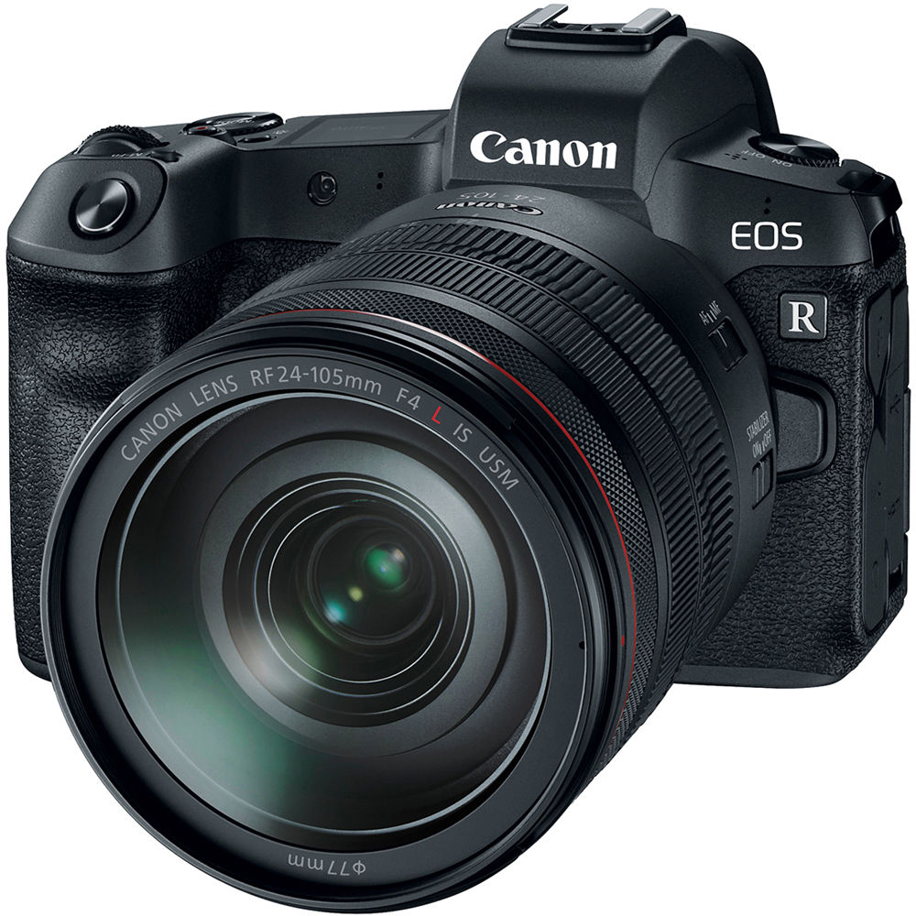
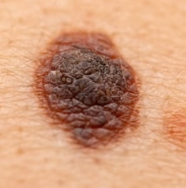
Motivation
Imaging System
Compression/Digitization Pipeline
Melanoma
Hypothesis
Learned compression can educate both imaging system design and image classification architectures

Slide 3
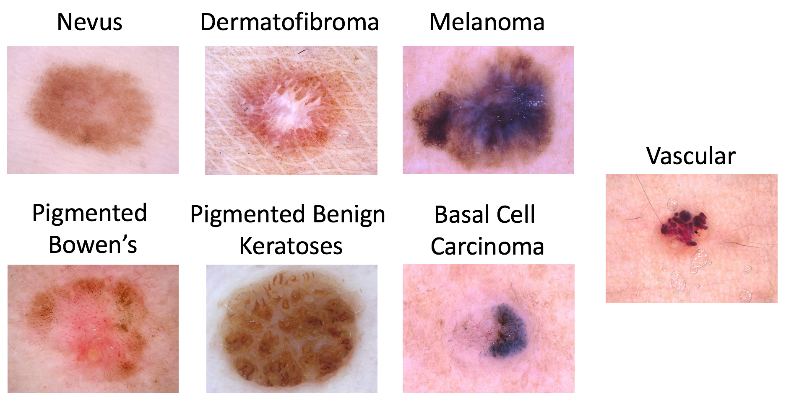
Dataset
Human Against Machine (HAM)-10000
10015 Dermatological Images

Slide 4
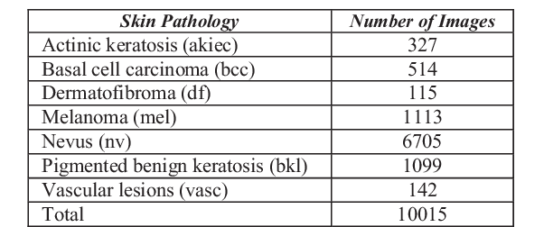
Dataset
PRO: Representative of images that could be taken with a smartphone
CON: Uneven label distribution

Slide 5
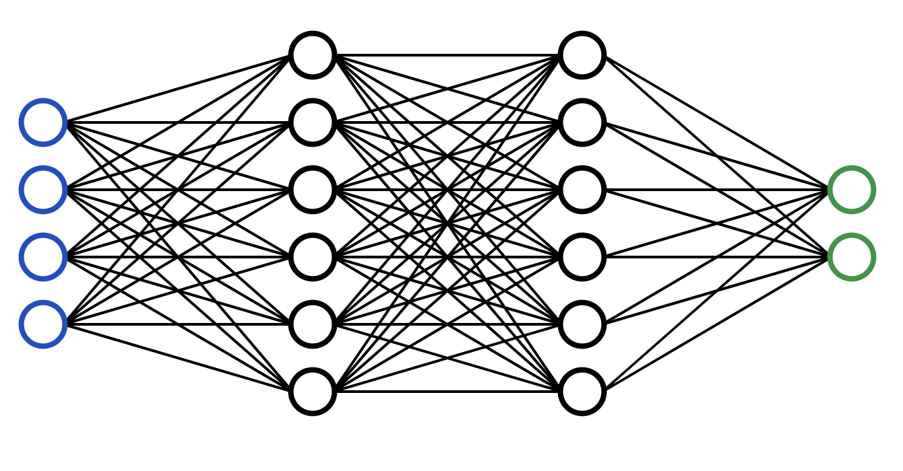
Objective 1
1. Classify HAM-10000

Slide 6
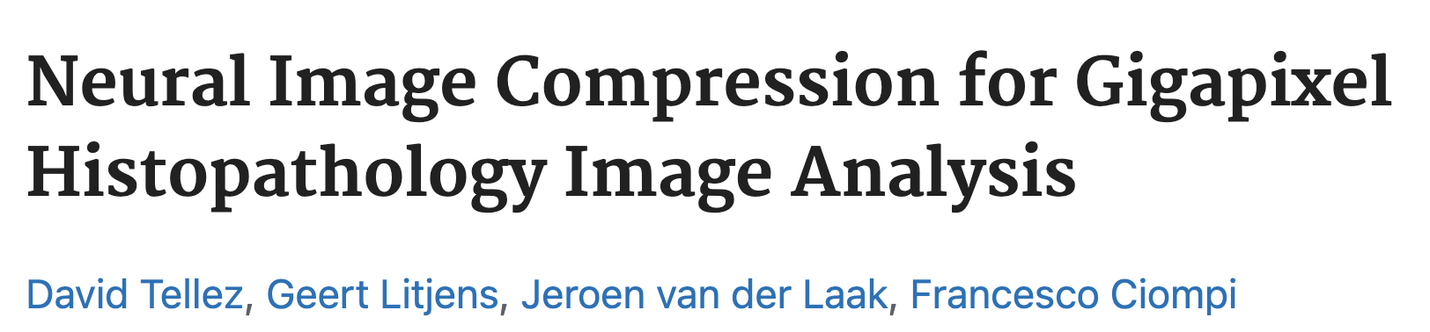
Objective 2
Current standard image compression is done as JPEG/PNG (etc.)
Image compression is moving towards Neural Image Compression (NIC)

Slide 7
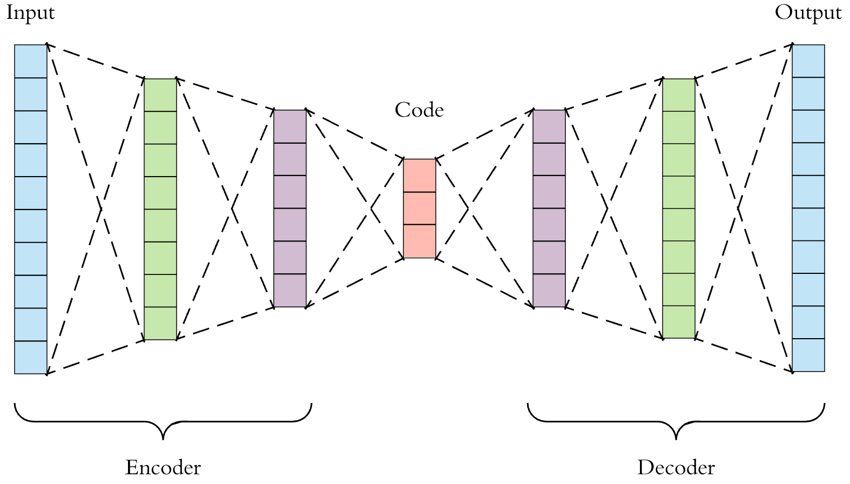
Objective 2
Score
Image
Compressor
Classify
Optimize
2a. Learn a compression scheme for HAM-10000 images
2b. See how effective this compression is by analysis using the classifier

Slide 8
Objective 3
Score
Optimize Together
Image
Compressor
Classify
2a. Learn a compression scheme jointly with the classifier for HAM-10000 images
2b. After training, extract images and observe “optimal image” for classifier

Slide 9
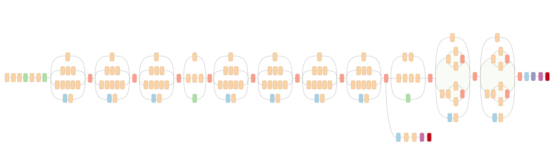
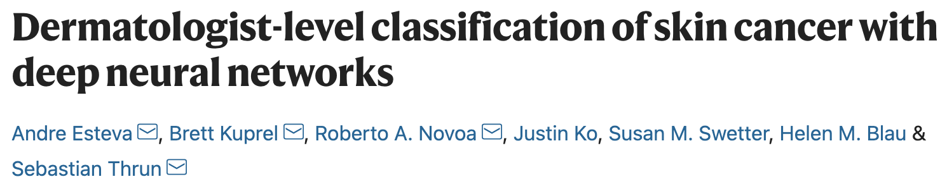
Classifier Architecture
Class
Image
(128,128,3)
InceptionV3
(Imagenet weight initialization)
Dense
(7 Nodes)
Dense
(128 Nodes)

Slide 10
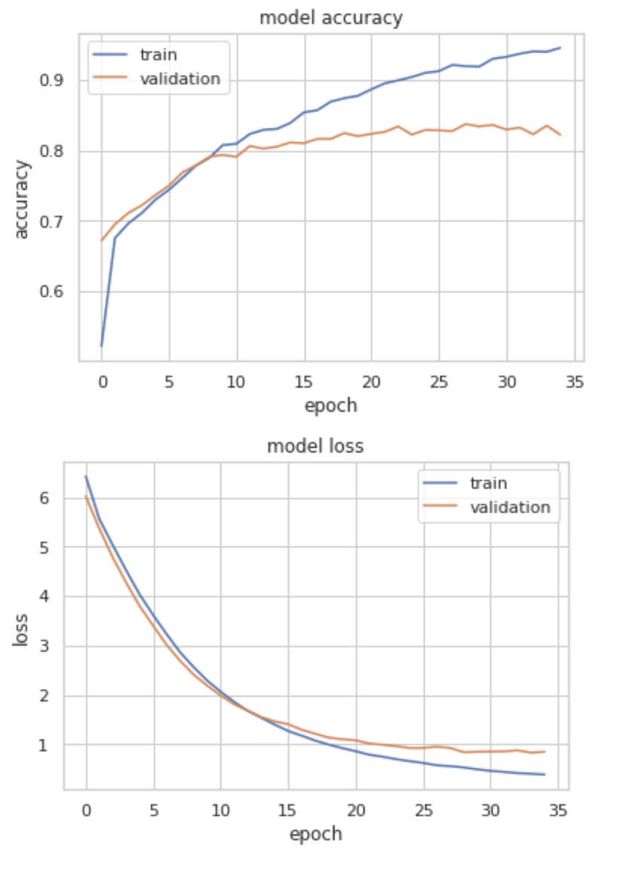
Details
70/20/10 Train/Validation/Test Split
Adam optimizer
L2 regularization
Data Augmentation
Categorical Crossentropy Loss
Normalize inputs to 0-1
Trained for 35 Epochs

Slide 11
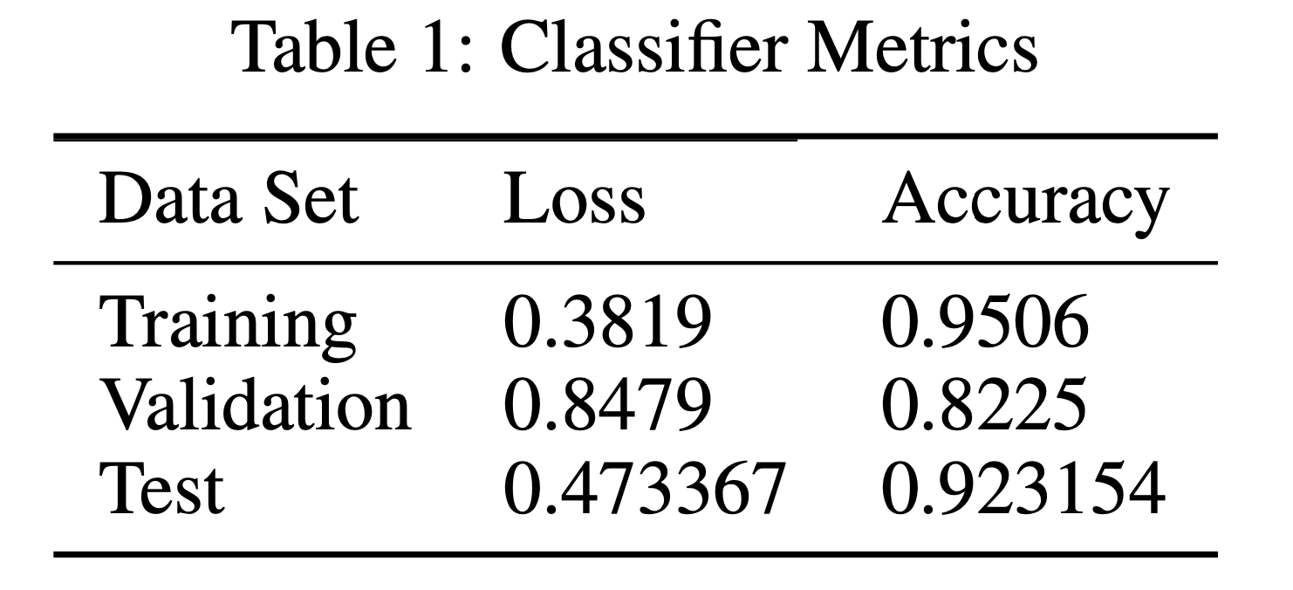
Classifier Performance

Slide 12
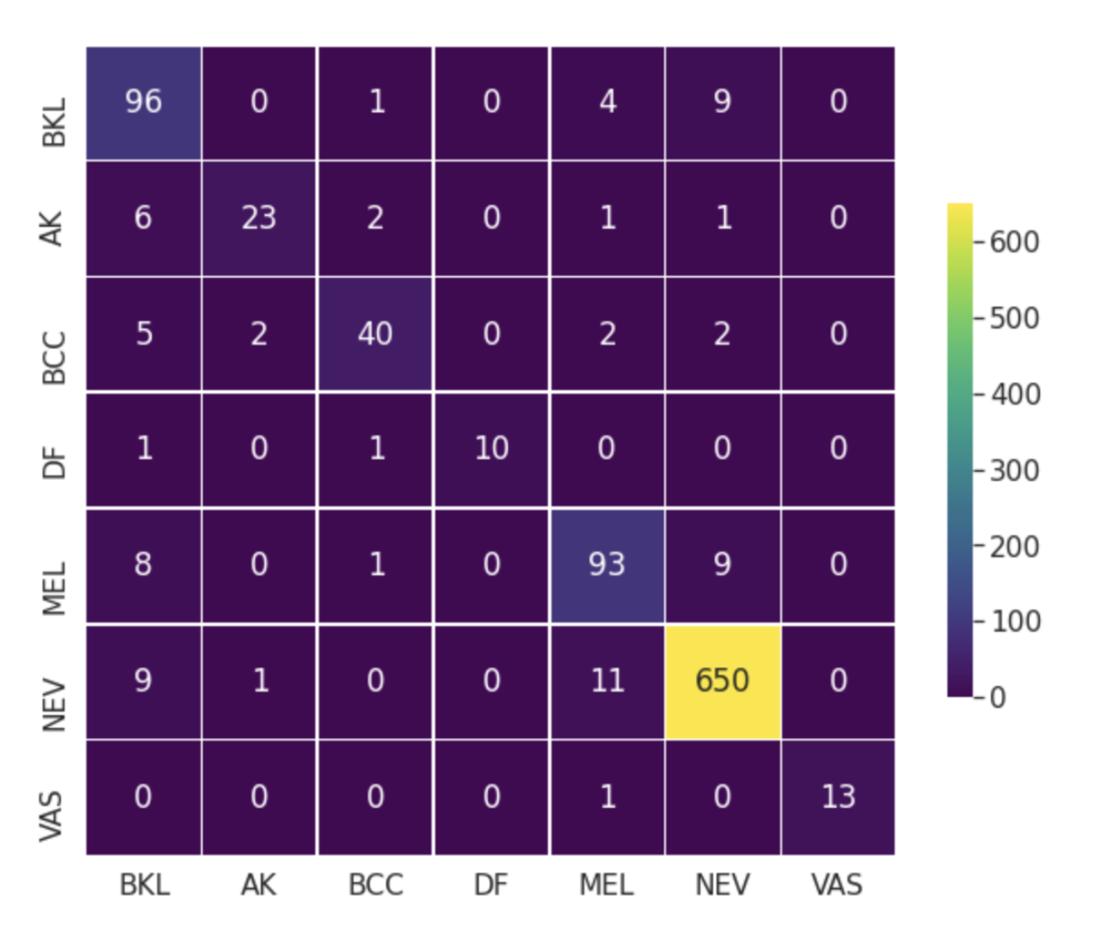
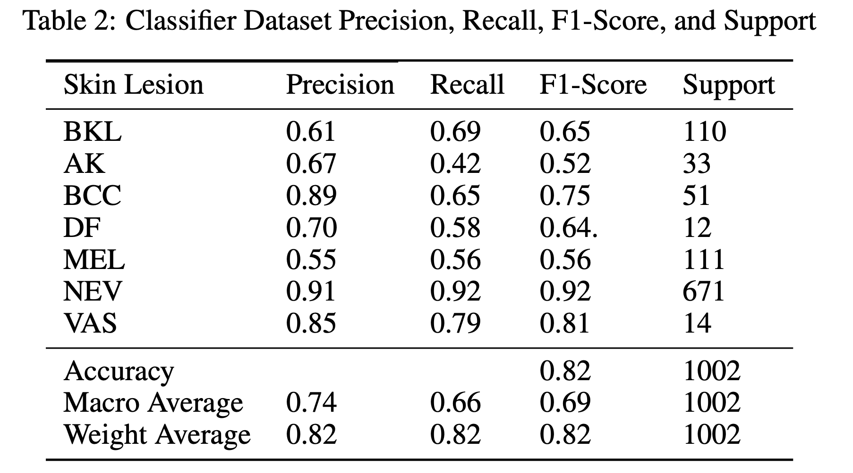
Classifier Performance
Good at NEV, Bad at MEL, BKL

Slide 13
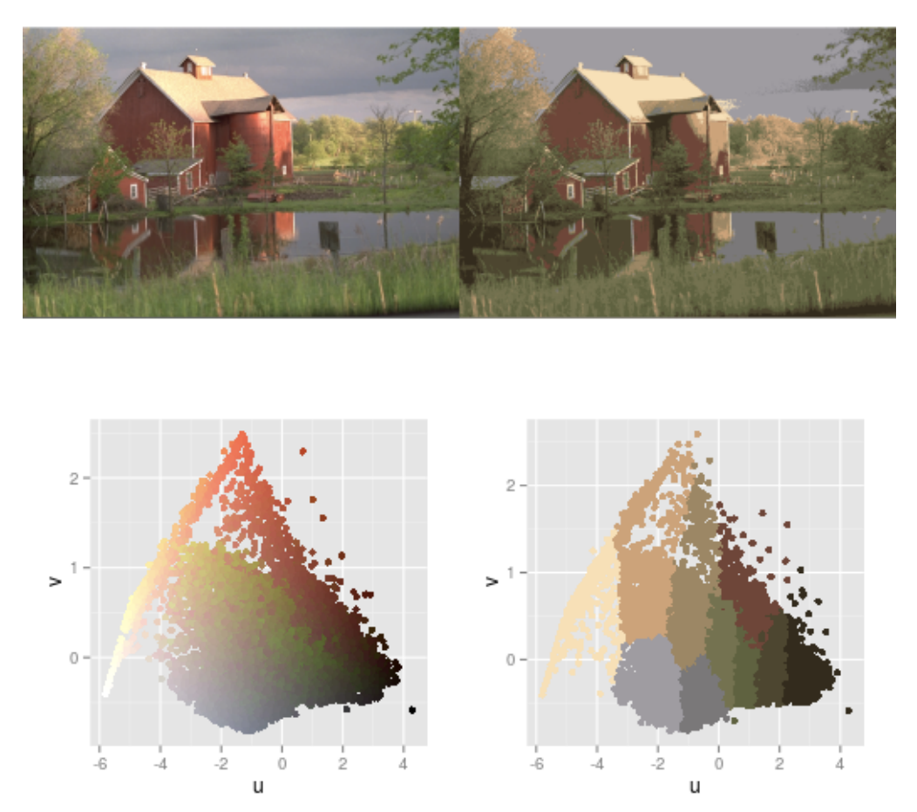
Compression Method
Naïve, first attempt: K-Means Clustering
Carlo Tomasi, Duke CS371

Slide 14
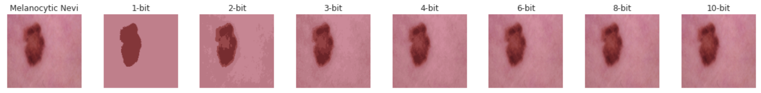
Results
Key Issue: Not jointly trainable with the classifier.
Average Color
Deviation
36.05
22.03
14.00
10.11
6.00
3.95
2.35

Slide 15
Autoencoder
Low-Dimensional Encoding
Image
(128,128,3)
Image
(128,128,3)
Latent Space

Slide 16
Autoencoder Architecture
2x
“SegNet”-like architecture
2x
Conv
Conv
Conv
Conv
Pool
Upsample
Reconstructed Image
(128,128,3)
49152
Image
(128,128,3)
49152
32,786 (1.5x)
16,384 (3x)
8192 (6x)

Slide 17
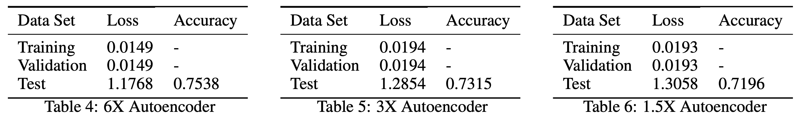
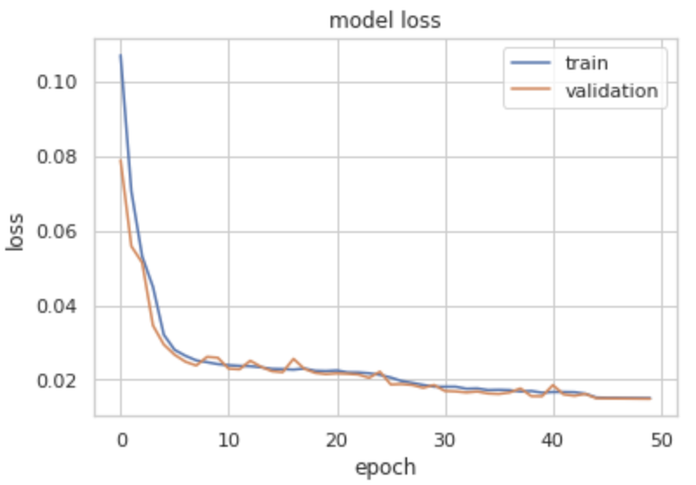
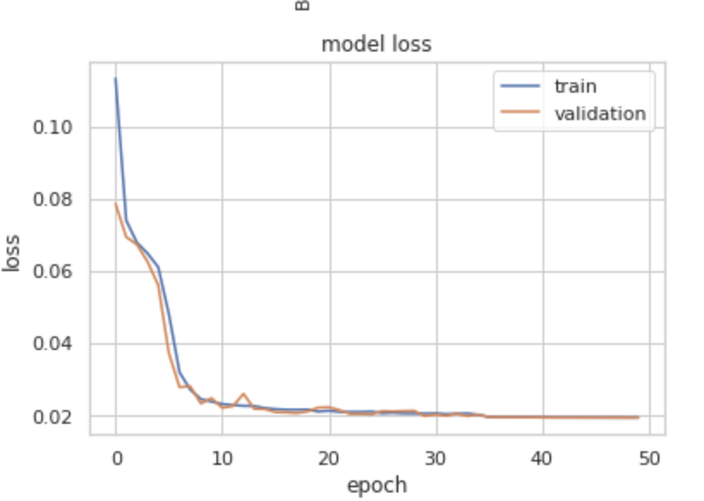
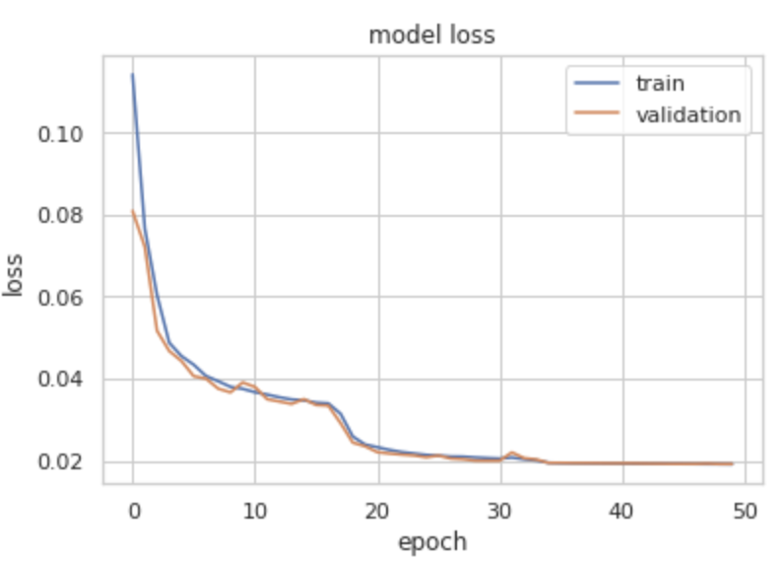
Training Details
Train for 50 epochs
Mean Absolute Error loss
(6x)

Slide 18
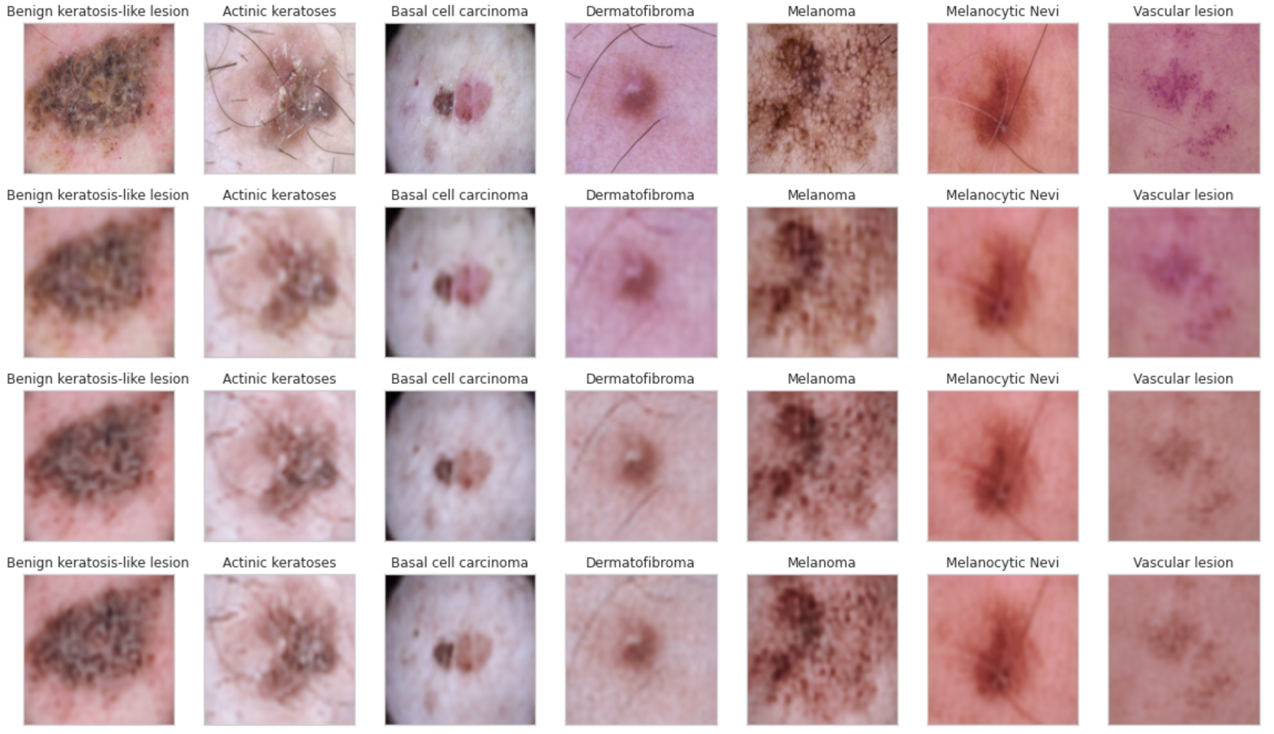
Autoencoder Results
Original
Test Accuracy
6X Compressed
0.7538
3X Compressed
0.7315
1.5X Compressed
0.7196

Slide 19
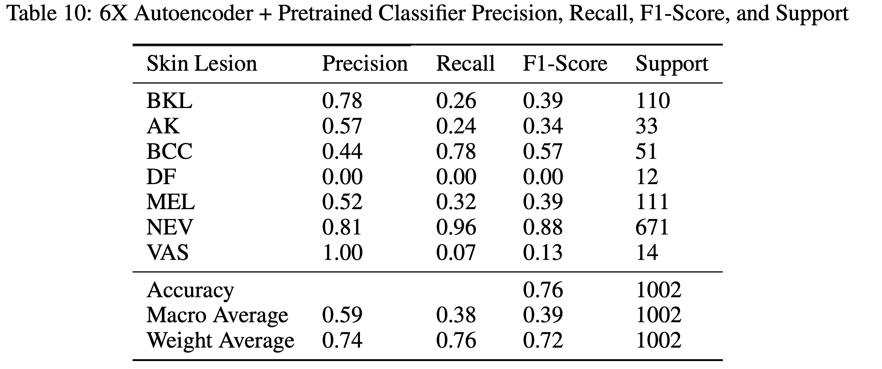
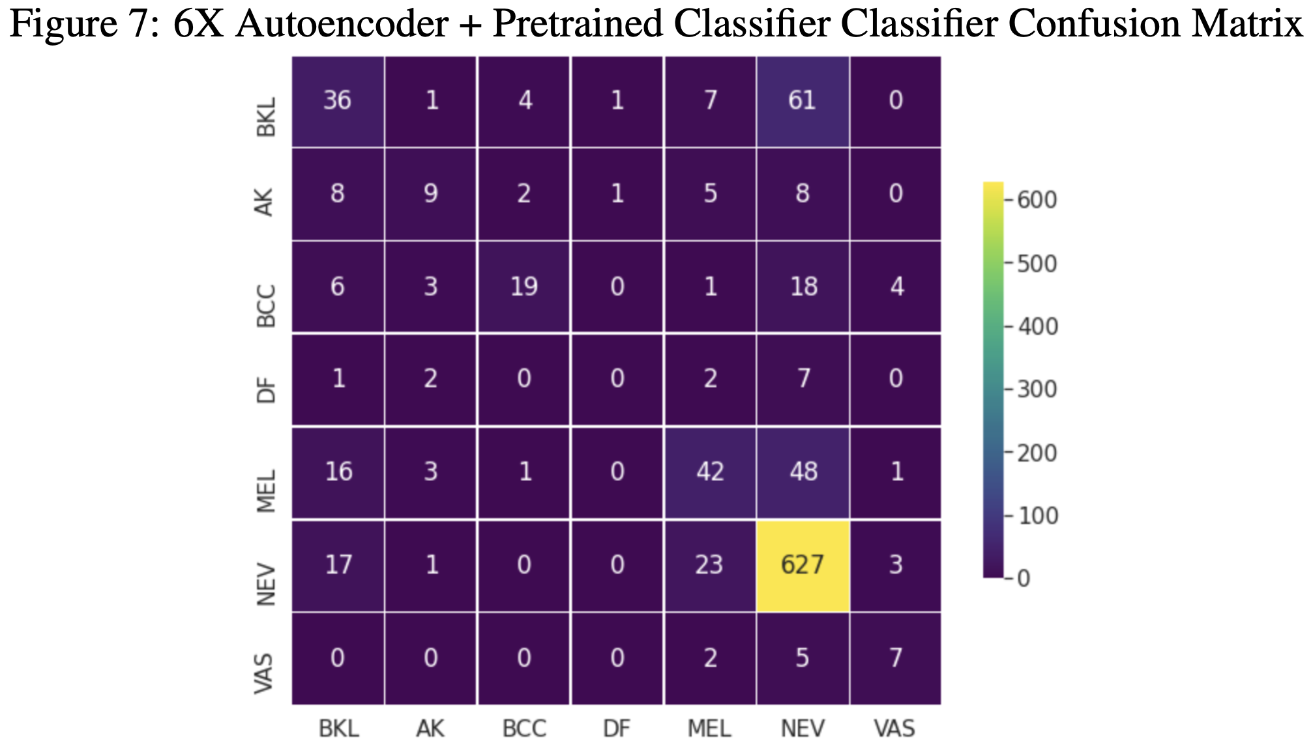
Autoencoder Results – 6X

Slide 20
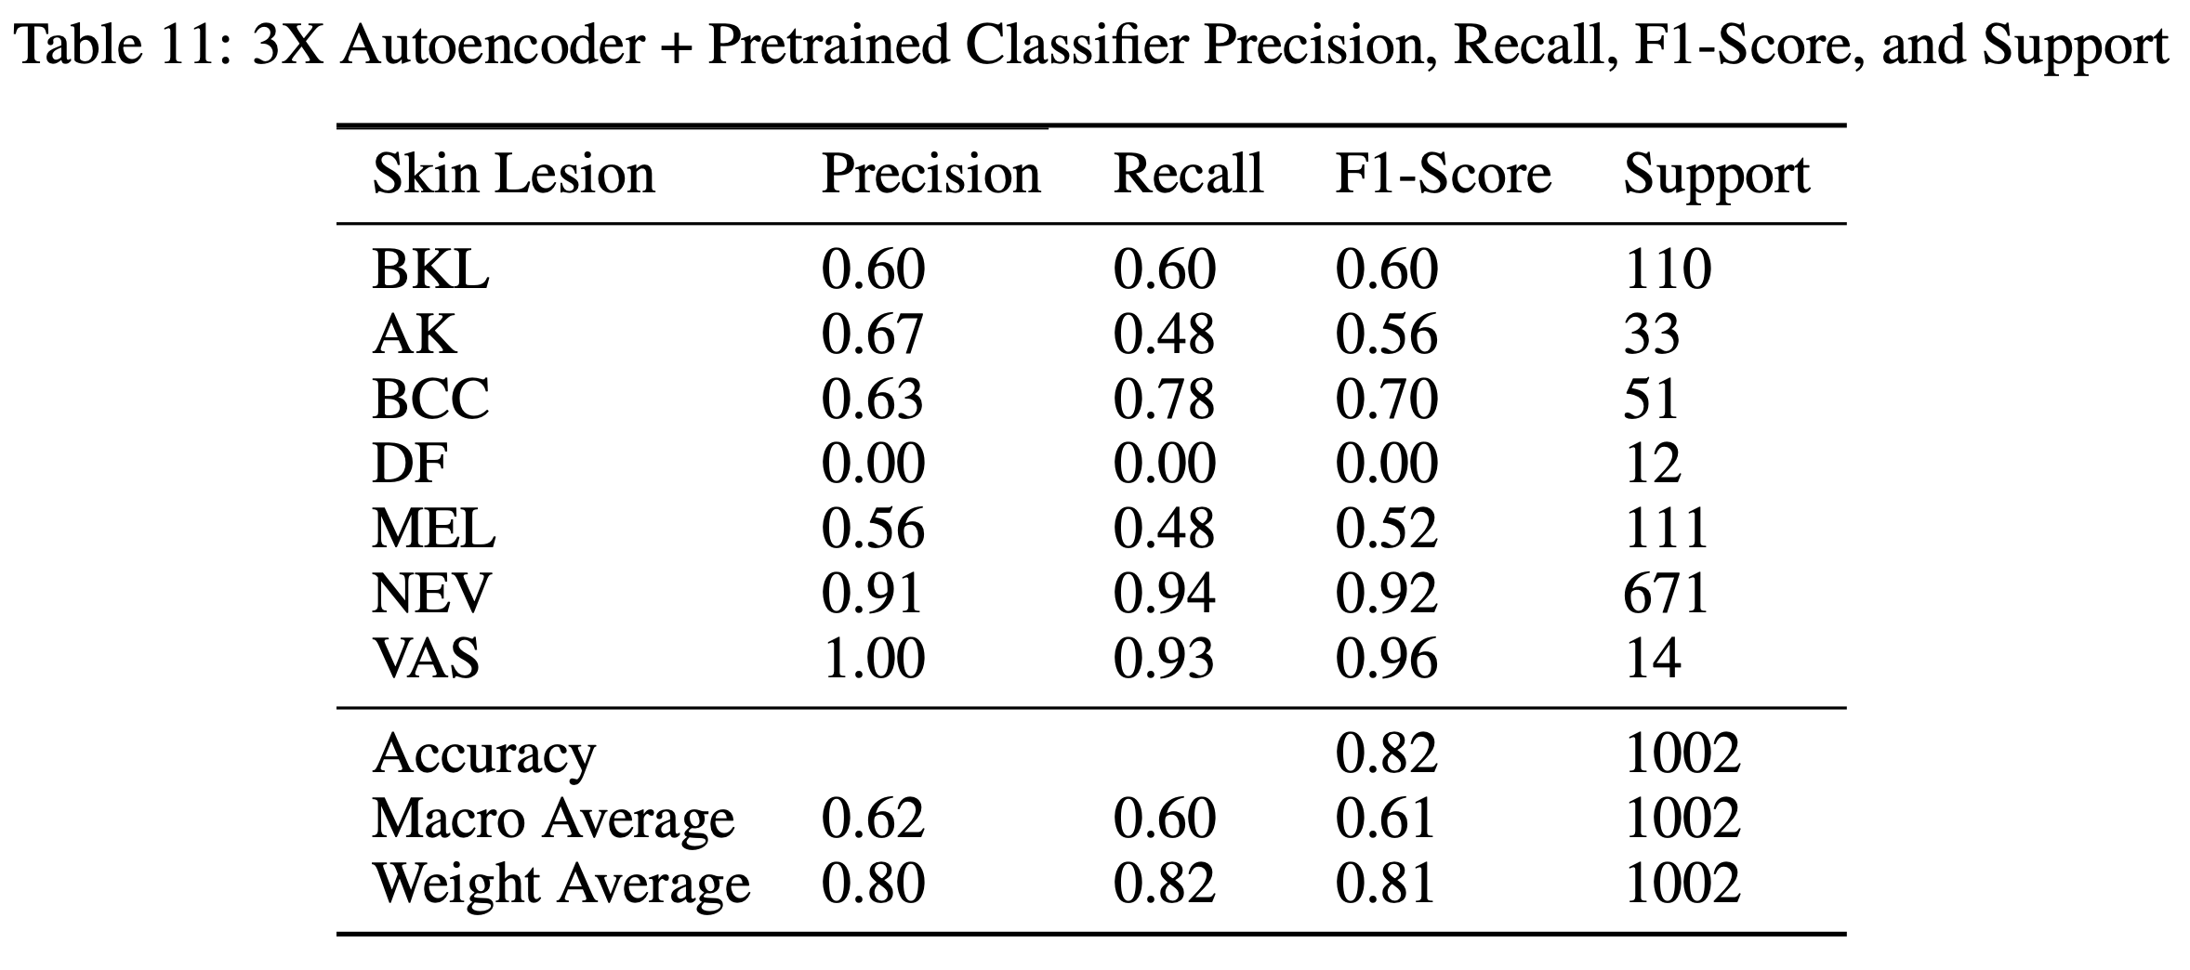
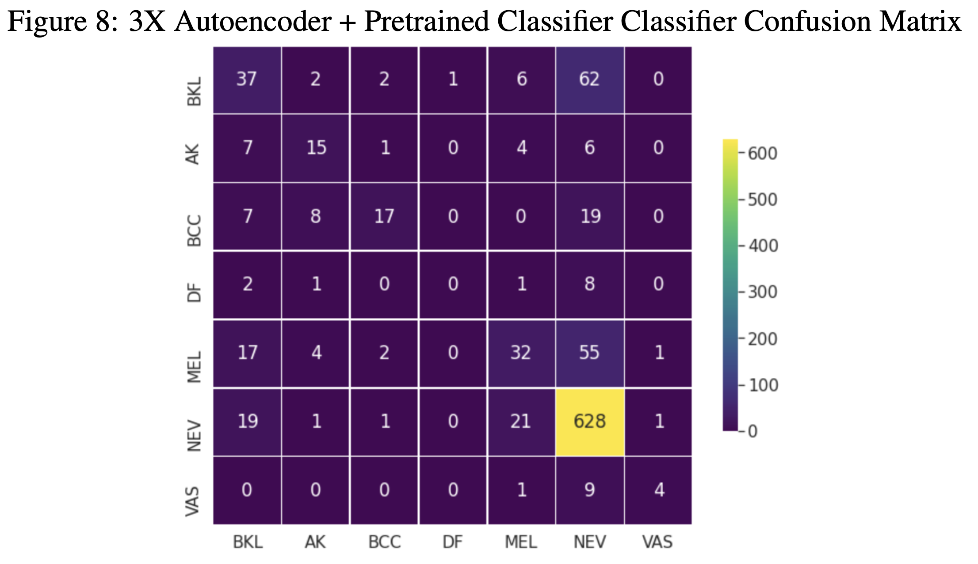
Autoencoder Results -3X

Slide 21
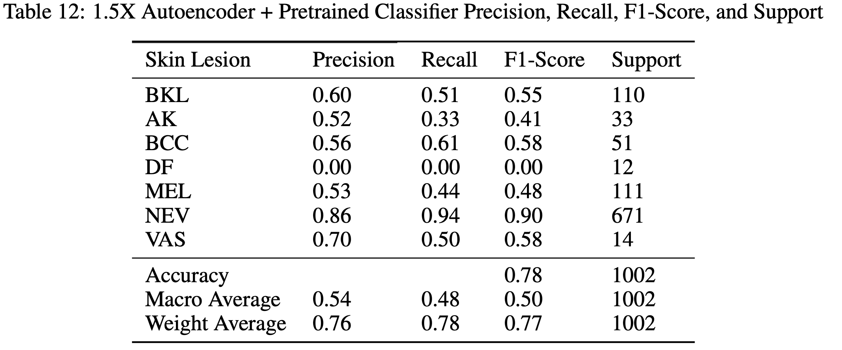
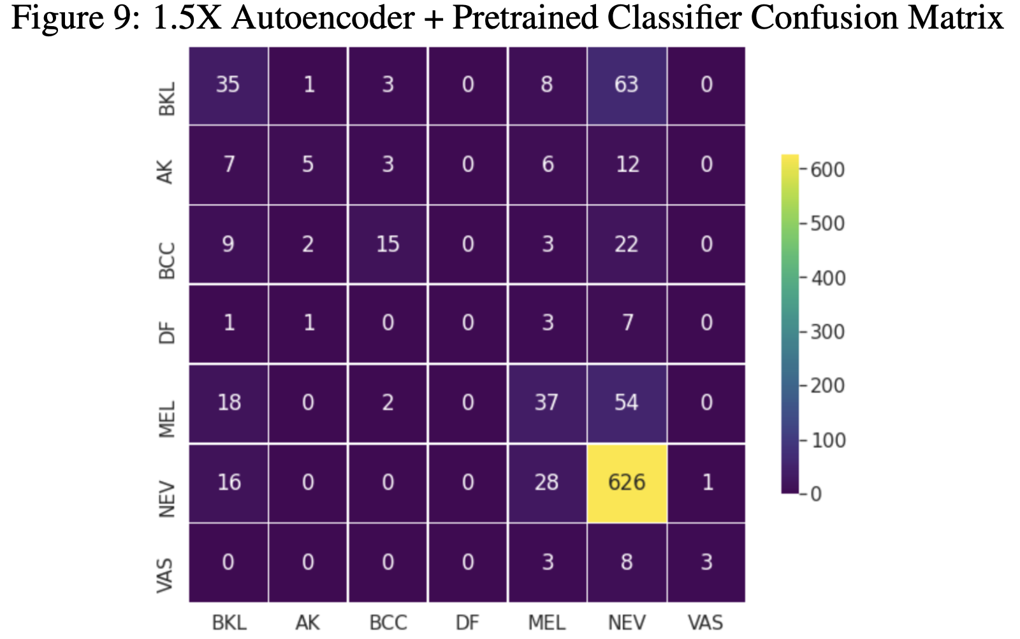
Autoencoder Results -1.5X

Slide 22
Autoencoder Results Summary
All three autoencoders had similar accuracies, with the 6X being the most accurate and 1.5X being the least accurate on test set
All three models did the best at classifying NEV
All three models were unable to properly classify DF

Slide 23
Joint Training Architecture
Score
Compressor
Classify
Image
(128,128,3)
Optimize Together

Slide 24
Training Details
70/20/10 Train/Validation/Test Split
Adam optimizer
L2 regularization
Data Augmentation
Categorical Crossentropy Loss
Normalize inputs to 0-1
Trained for 35 Epochs
Checkpointing due to unstable validation accuracy

Slide 25
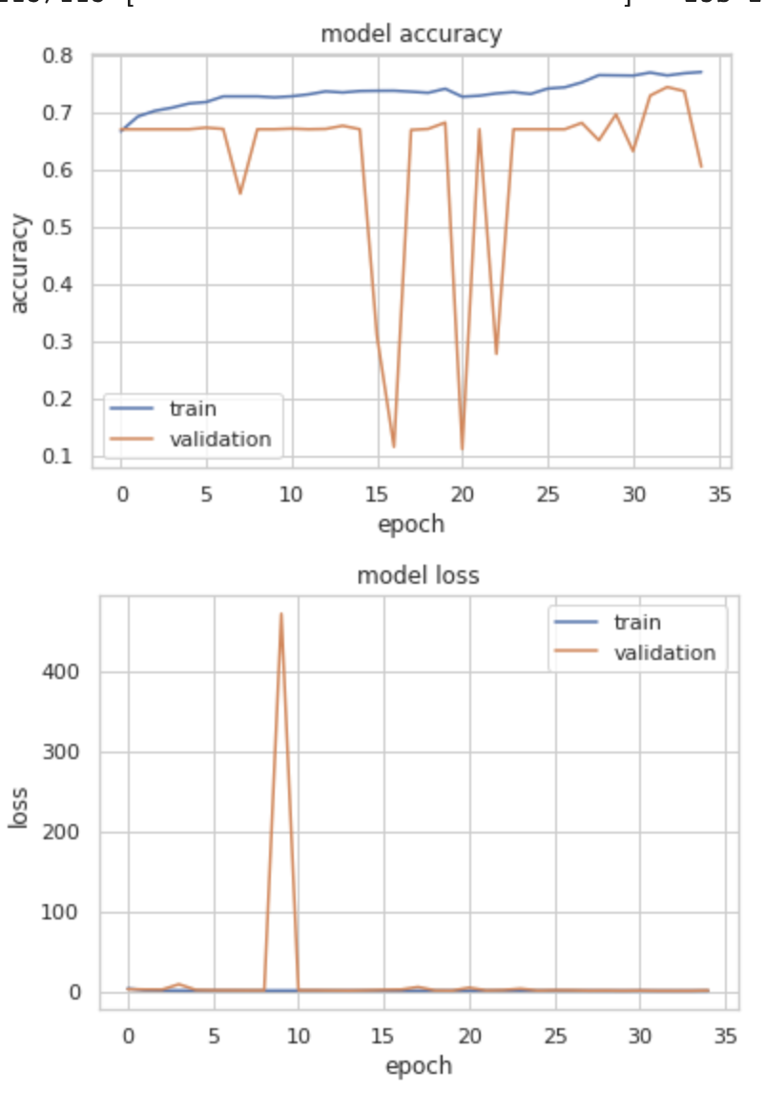
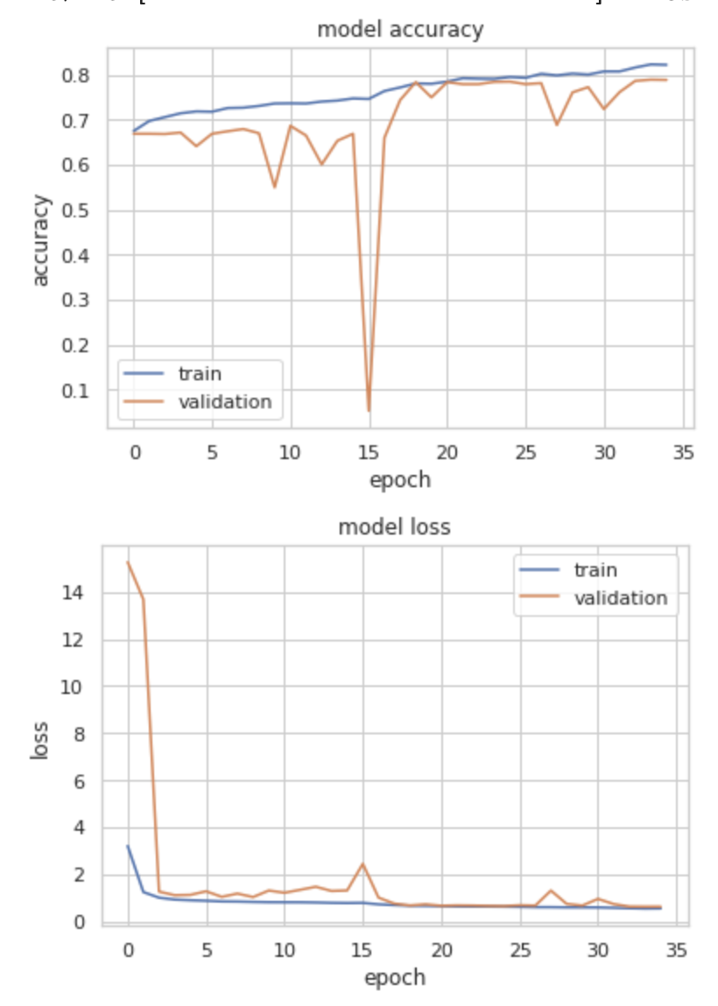
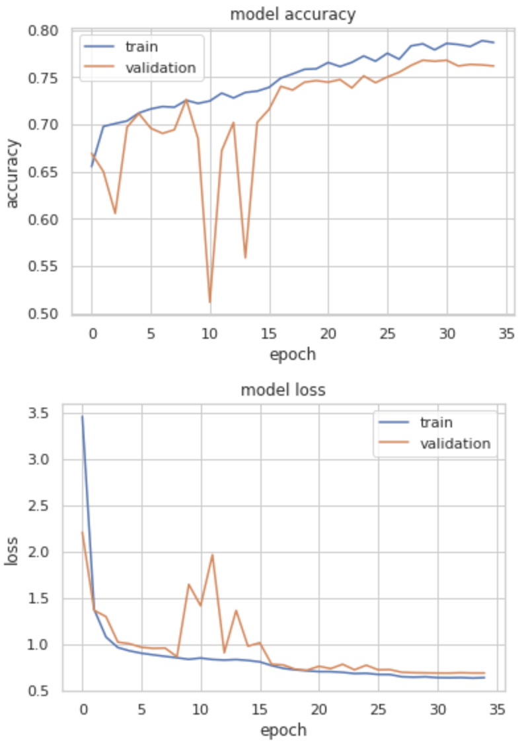
Training Details
1.5X
3X
6X

Slide 26
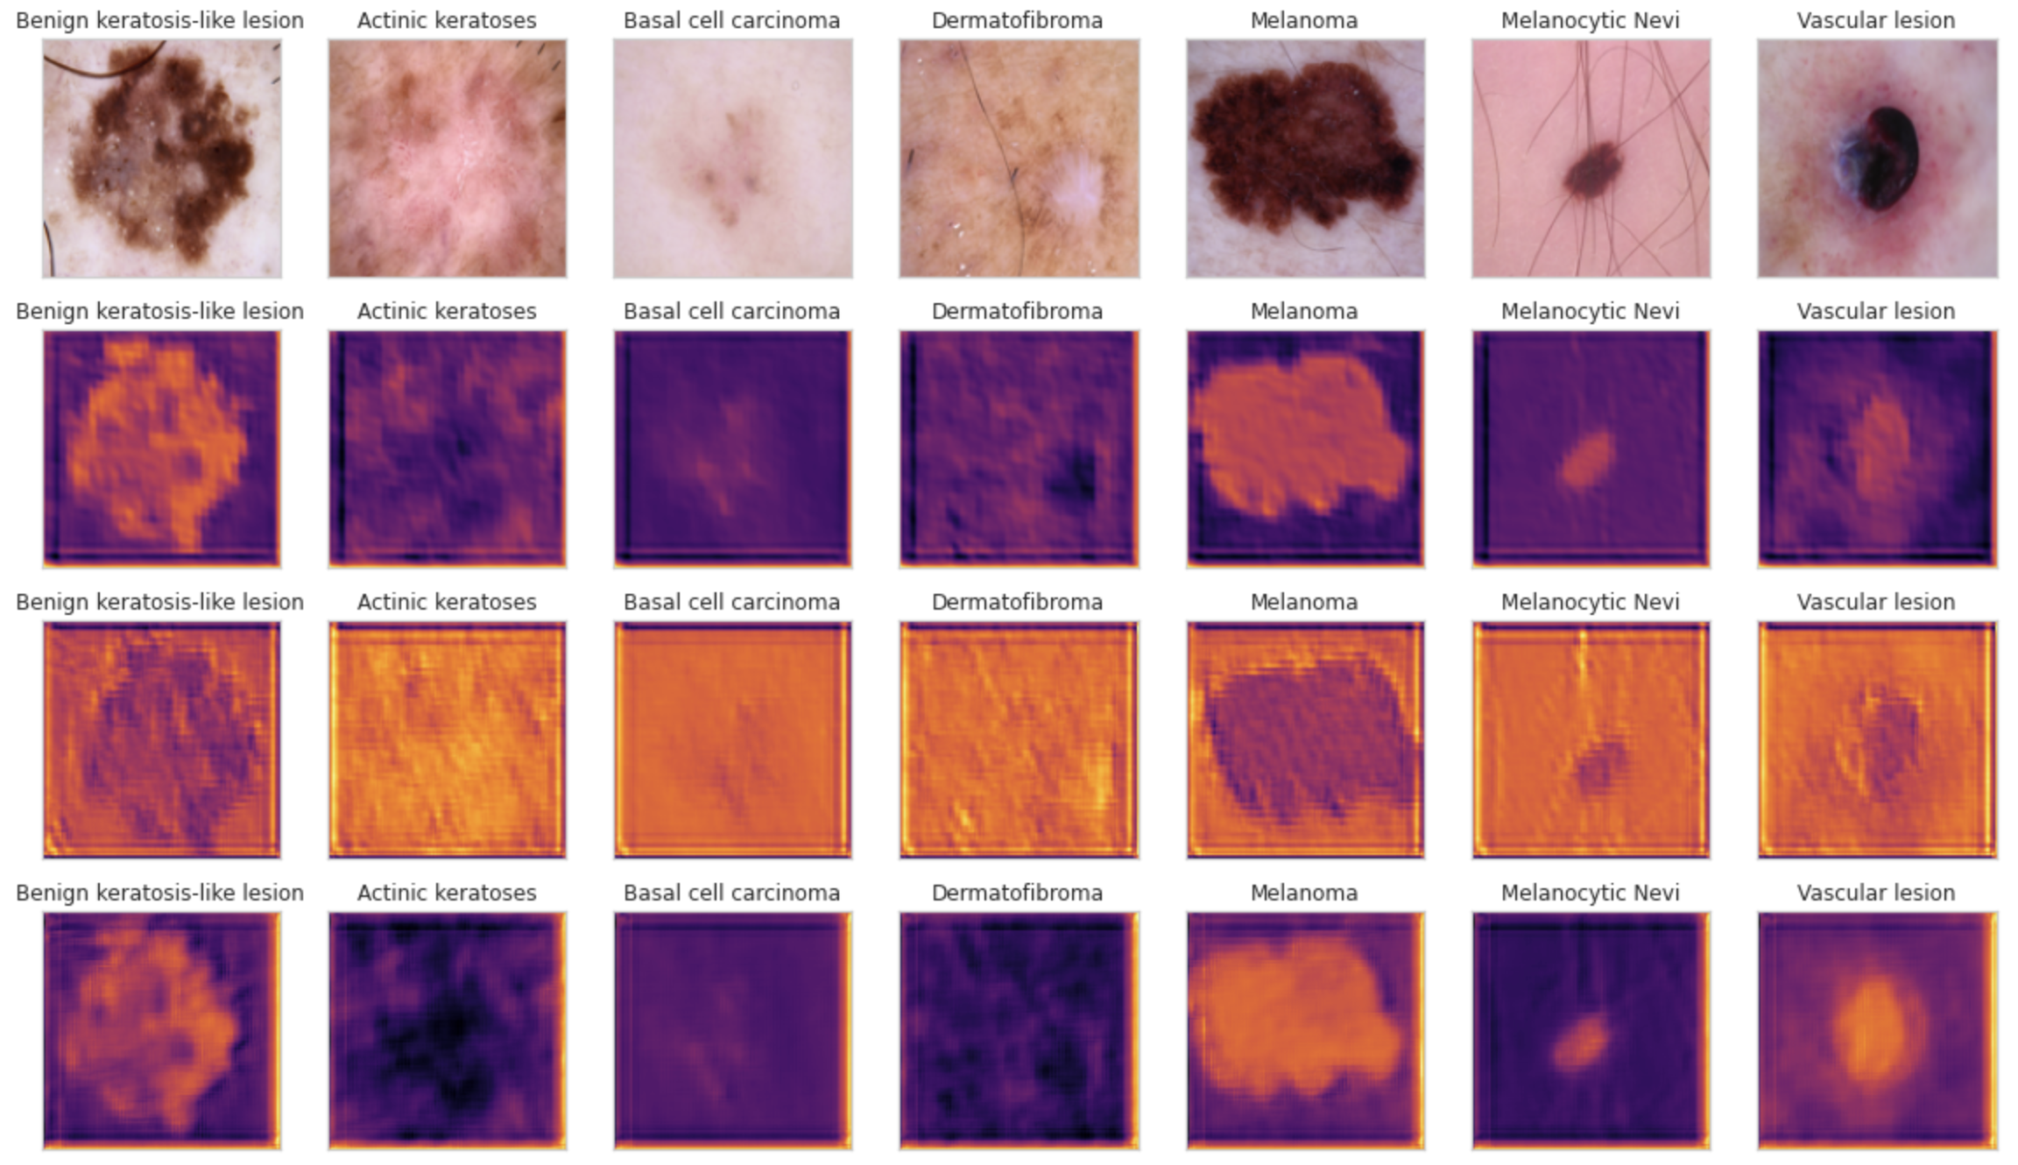
Joint Training Results
Original
Test Accuracy
6X Compressed
0.7555
3X Compressed
0.8183
1.5X Compressed
0.7814
Contrast is critical for classification!
Zghal, Nadia Smaoui, and Imene Khanfir Kallel. 2020.
Notes:
Zghal, Nadia Smaoui, and Imene Khanfir Kallel. 2020. “An Effective Approach for the Diag- nosis of Melanoma Using the Sparse Auto-Encoder for Features Detection and the SVM for Classification.” In 2020 5th International Conference on Advanced Technologies for Signal and Image Processing (ATSIP), 1–6.

Slide 27
Joint Training Results
Original
6X
3X
1.5X
DF, BCC, AK have poor contrast, may suggest why model is confused.

Slide 28
Joint Training Results
Original
6X
3X
1.5X
BKL and MEL have similar contrast, theory for confusion matrix results

Slide 29
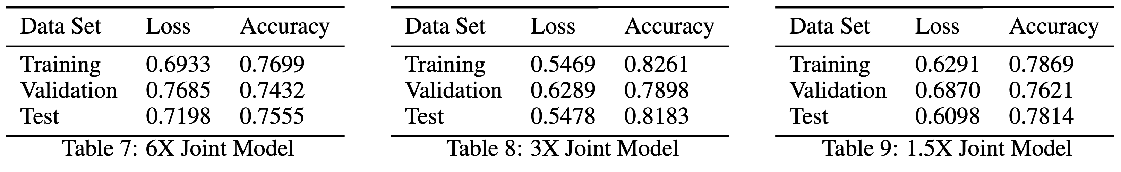
Joint Training Results
3X Encoder Architecture had the best performance

Slide 30
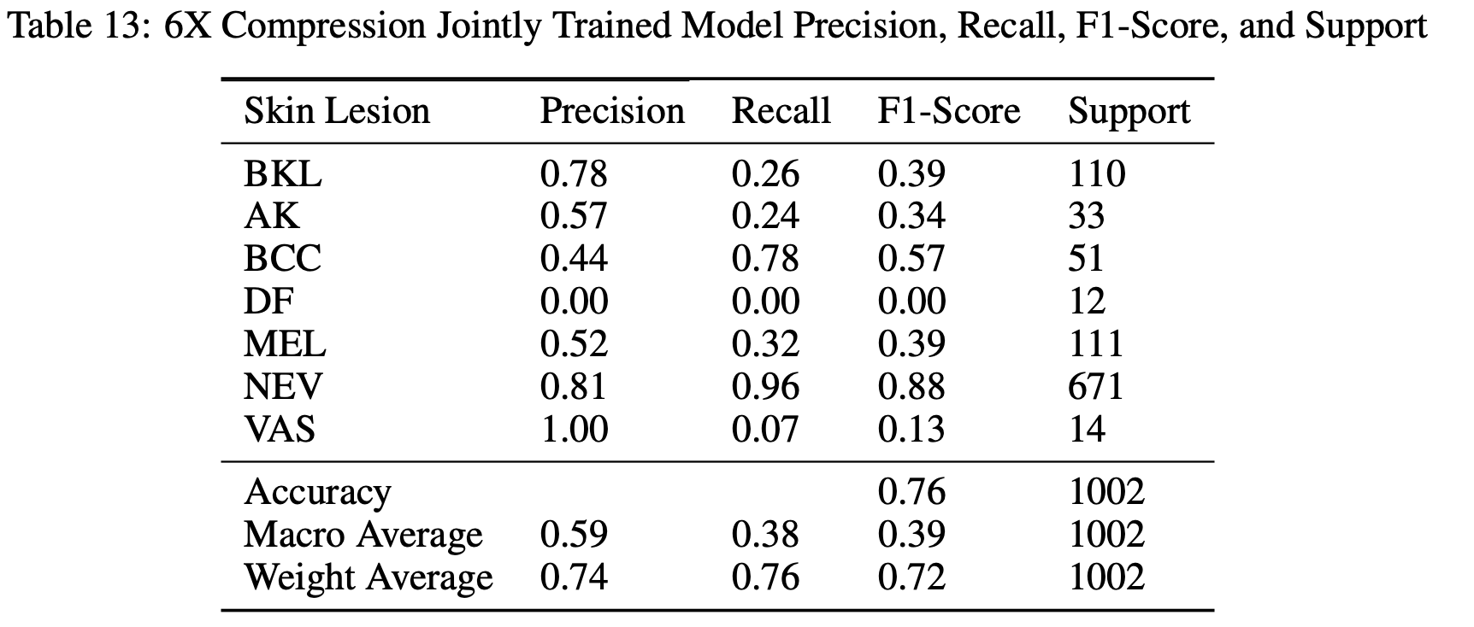
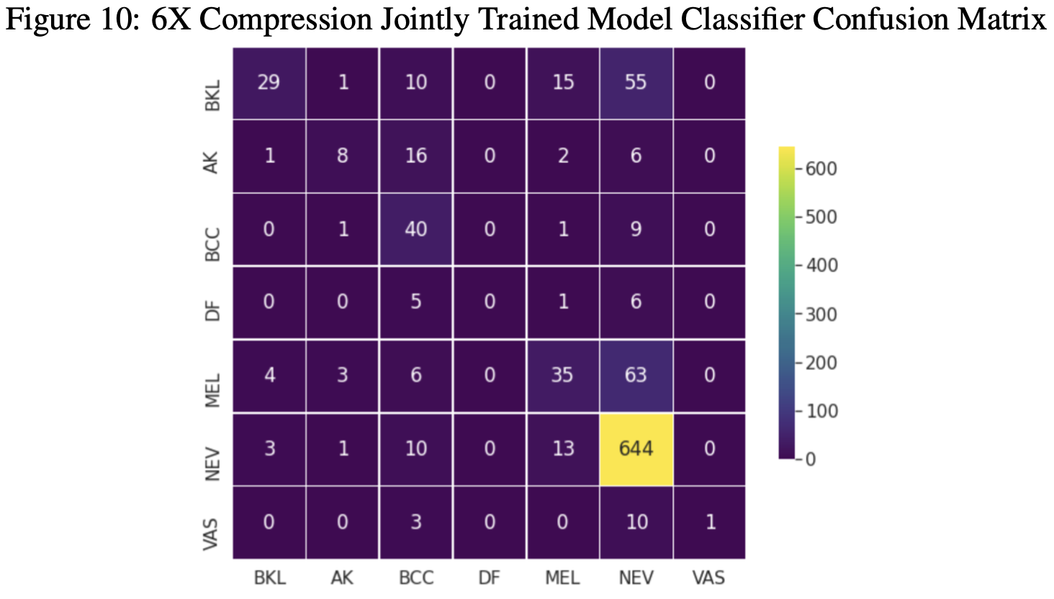
Joint Training Results – 6X

Slide 31
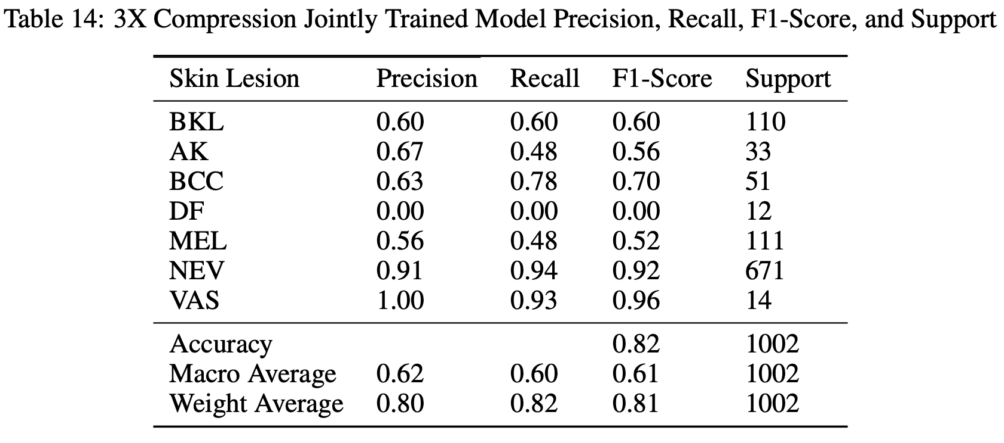
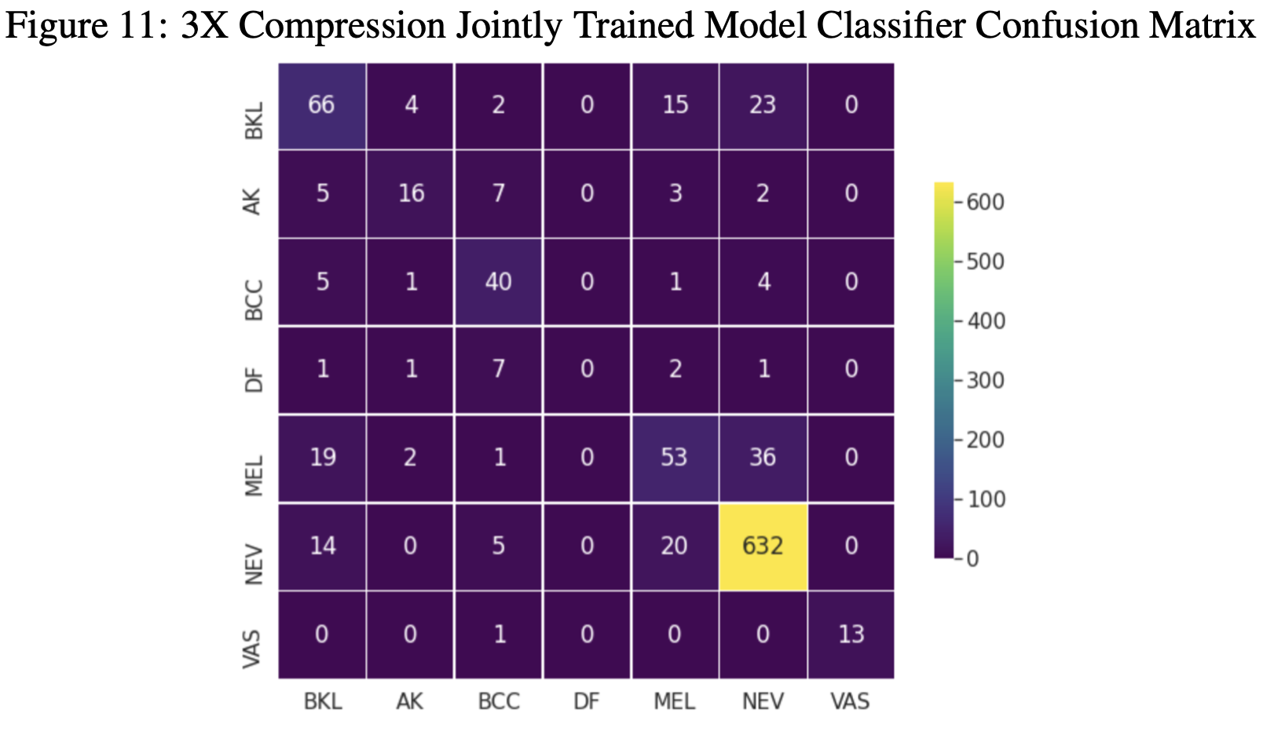
Joint Training Results – 3X

Slide 32
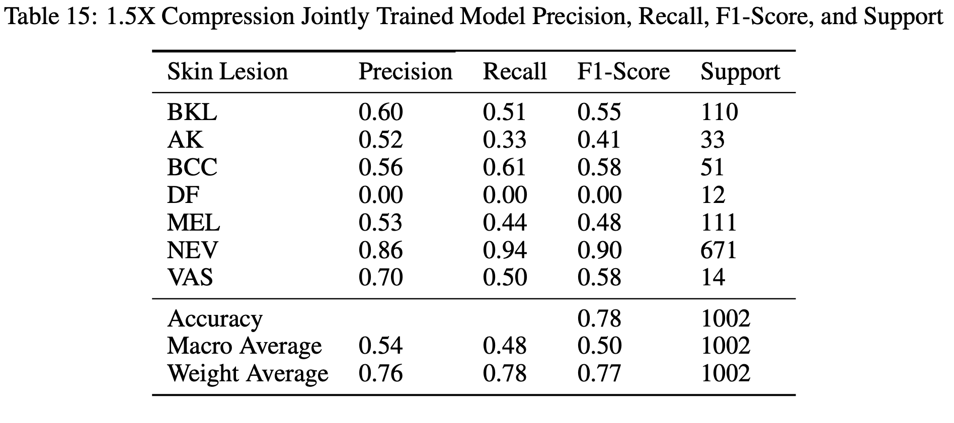
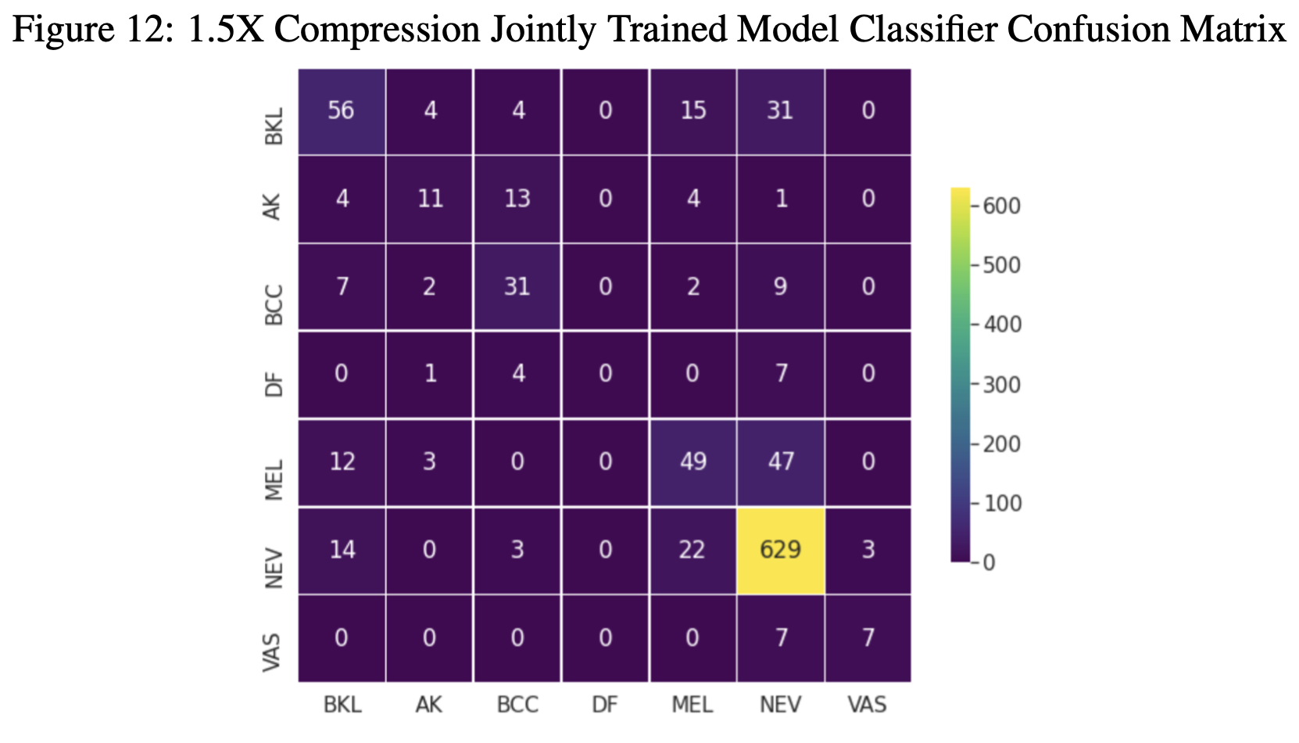
Joint Training Results -1.5X

Slide 33
Joint Training Results Summary
3X model had superior average precision and recall to 1.5X and 6X models.
Follows trend seen with autoencoder training
3X Model was able to distinguish vascular lesions from nevi, other two models were not
3X Model was superior at classifying BKL
All three models confused between BCC, AK, DF
3X Model test accuracy 10% less accurate than classifier alone (82%)
All three models performed the best on nevus classification

Slide 34
Takeaways
Image background contrast is critical for HAM-10000 classification
Imaging scheme: highlight contrast between lesion and background
Compression scheme: possible to only encode boundaries between lesion and background
Latent space size may not directly be correlated to compression effectiveness
Autoencoder effectiveness may not be directly correlated to classification effectiveness

Slide 35
Future Steps
Train physical layer that serves as an edge detection filter, add to front of joint model and observe performance.
Address unbalanced dataset issue
Test different underlying classification architectures

Slide 36
Thank you!
Score
Any questions?
Compressor
Classify
Image
(128,128,3)
Optimize Together

